Slide 1
Personal Computer (PC) Components
Engr. Md. Abdur Rashid
Director (Admn & Finance)
NAPD

Slide 2
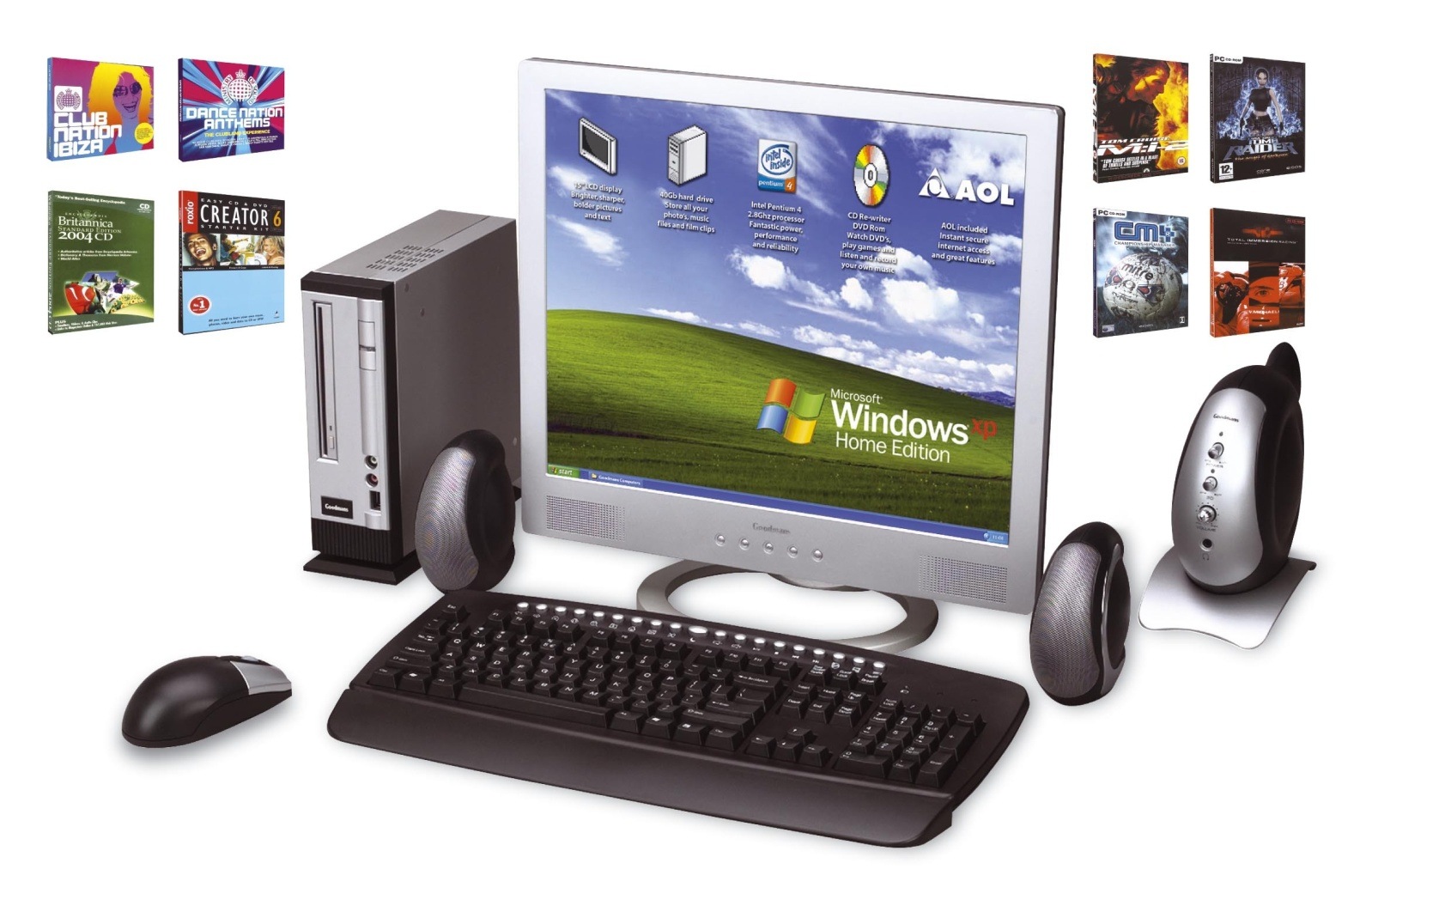
Personal Computer
A Personal Computer (PC) is a computer, in a
small cabinet or case that is sized to fit on a
desk.

Slide 3
Personal Computer Components
Monitor
Mouse
Keyboard
System Unit
Casing
Motherboard (Main board)
Processor (CPU)
Hard Disk Drive (H.D.D)
Random Access Memory (RAM)
Accelerated Graphics Port (AGP)
Sound Card
CD ROM / DVD ROM / CD Writer / DVD Writer

Slide 4
Other Components
LAN (Local Area Network) Card
Printer
MODEM
Scanner
Pen Drive

Slide 5
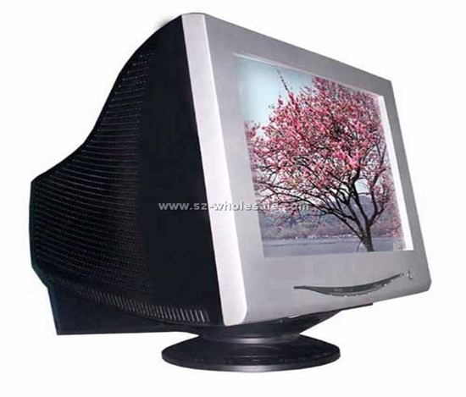
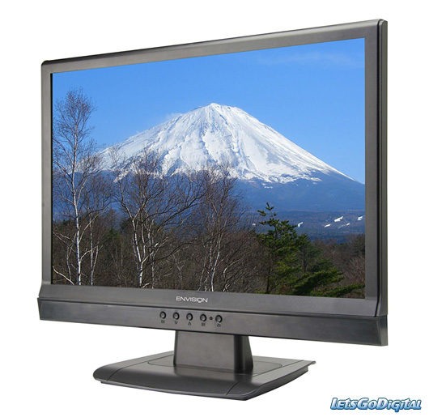
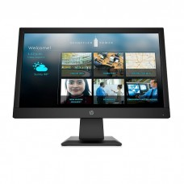
1. Monitor
CRT
LCD (Liquid Crystal Display) Monitors
LED (Light emitting Diode)

Slide 6
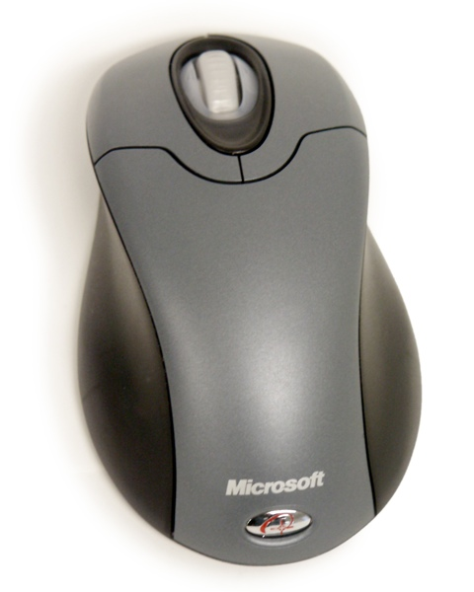
2. Mouse
Wired Mouse. A wired mouse connects directly to your desktop or laptop, usually through a USB port, and transmits information via the cord. ...
Bluetooth Mouse. ...
Trackball Mouse. ...
Optical Mouse. ...
Laser Mouse. ...
Magic Mouse. ...
USB Mouse. ...
Vertical Mouse.

Slide 7
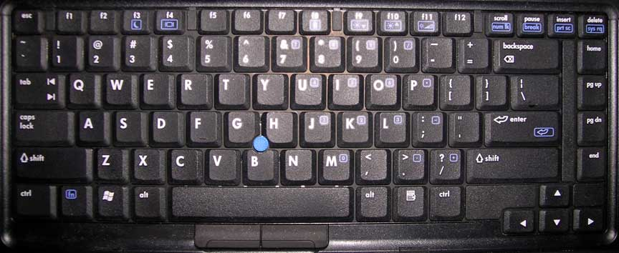
3. Keyboard
PS/2 keyboard
b. USB(Universal Serial Bus) keyboard

Slide 8
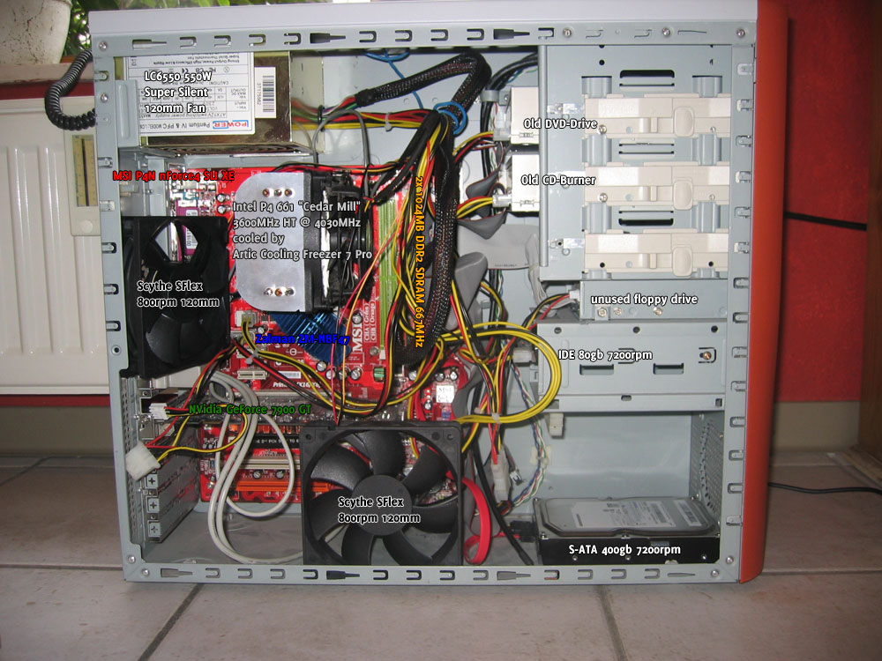
Casing

Slide 9
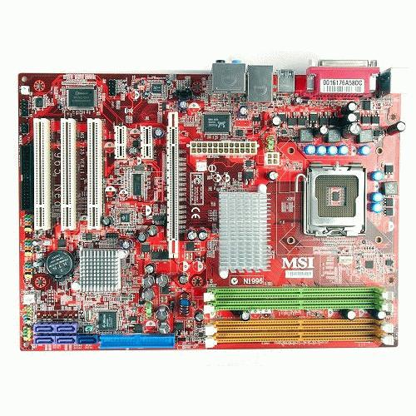
Motherboard
The motherboard is the board that contains the logic circuits that tie all parts of your PC together. It provides the connectors for the CPU, the memory, BIOS, CMOS, Video devices, sound devices, storage devices, chipsets, etc. in order to form an integrated set of components.

Slide 10
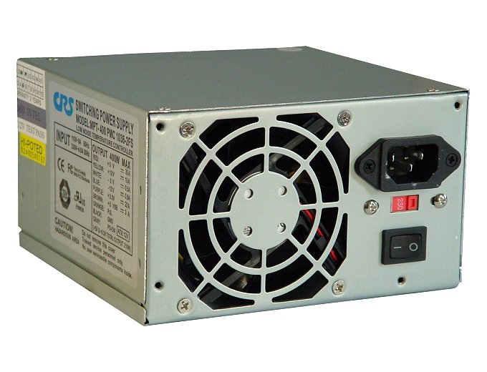
Power Supply Unit

Slide 11
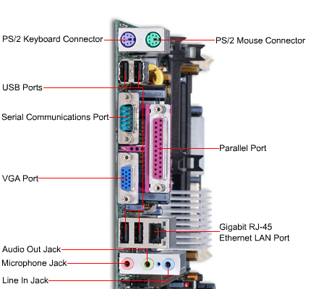
Motherboard Connections

Slide 12
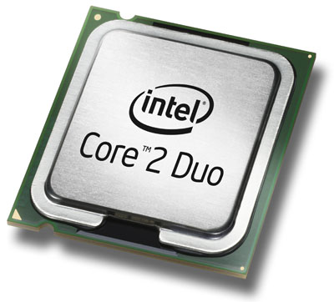
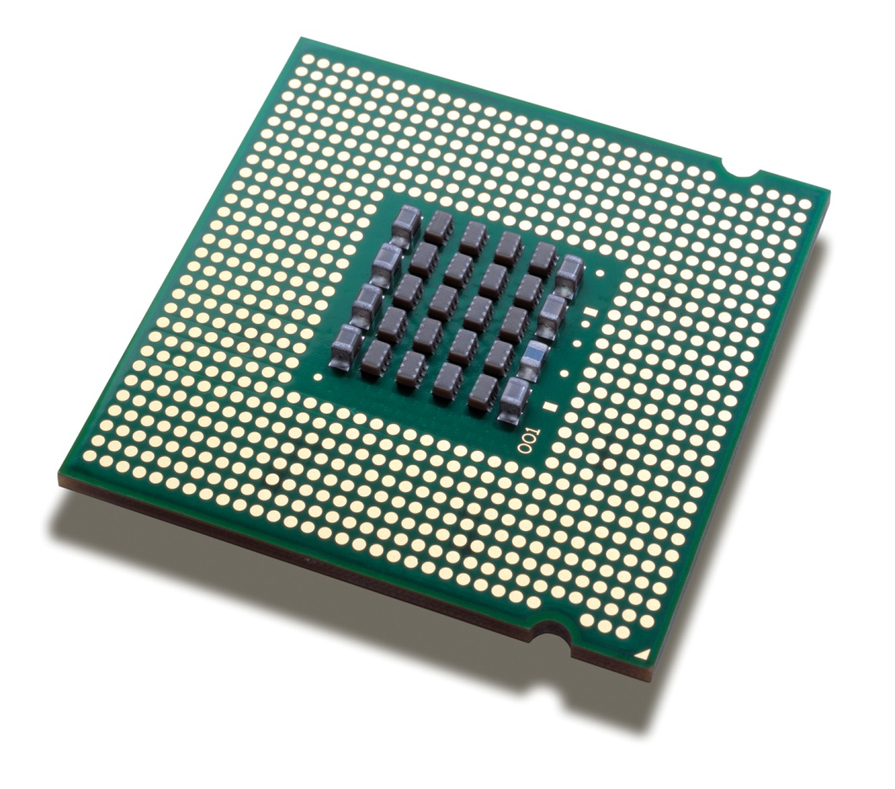
Processor (Central Processing Unit, CPU)

Slide 13
Intel Outline
Evolution of Intel Microprocessors
Scaling from 4004 to Pentium Core i7

Slide 14
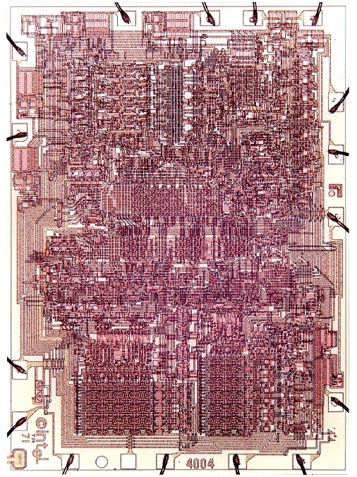
4004
First microprocessor (1971)
For Busicom calculator
Characteristics
10 μm process
2300 transistors
400 – 800 kHz
4-bit word size
16-pin DIP package
Masks hand cut from Rubylith
Drawn with color pencils
1 metal, 1 poly (jumpers)
Diagonal lines (!)

Slide 15
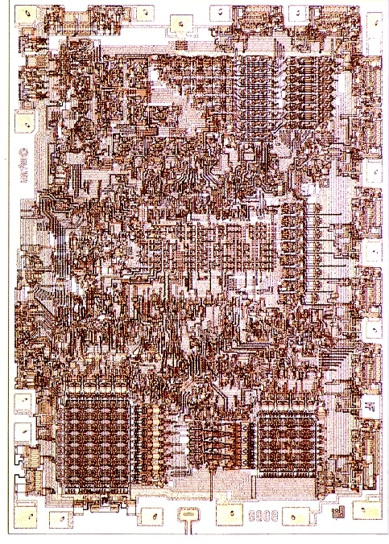
8008
8-bit follow-on (1972)
Dumb terminals
Characteristics
10 μm process
3500 transistors
500 – 800 kHz
8-bit word size
18-pin DIP package
Note 8-bit datapaths
Individual transistors visible

Slide 16
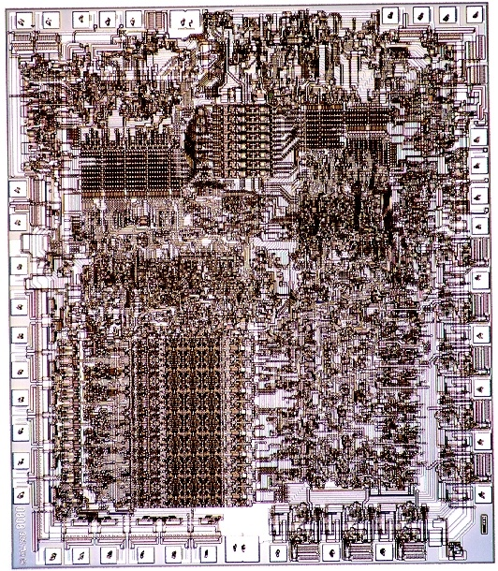
8080
16-bit address bus (1974)
Used in Altair computer
(early hobbyist PC)
Characteristics
6 μm process
4500 transistors
2 MHz
8-bit word size
40-pin DIP package

Slide 17
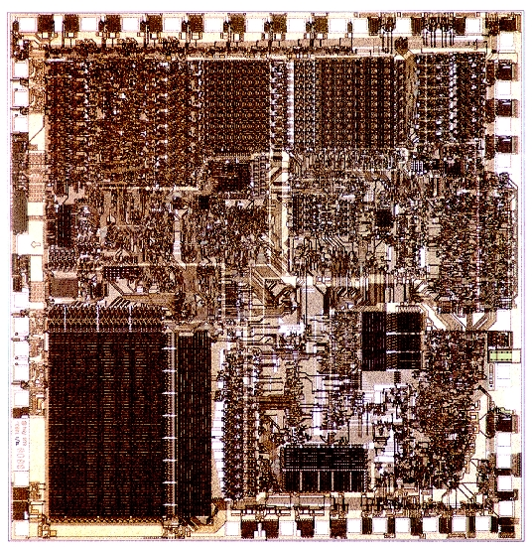
8086 / 8088
16-bit processor (1978-9)
IBM PC and PC XT
Revolutionary products
Introduced x86 ISA
Characteristics
3 μm process
29k transistors
5-10 MHz
16-bit word size
40-pin DIP package
Microcode ROM

Slide 18
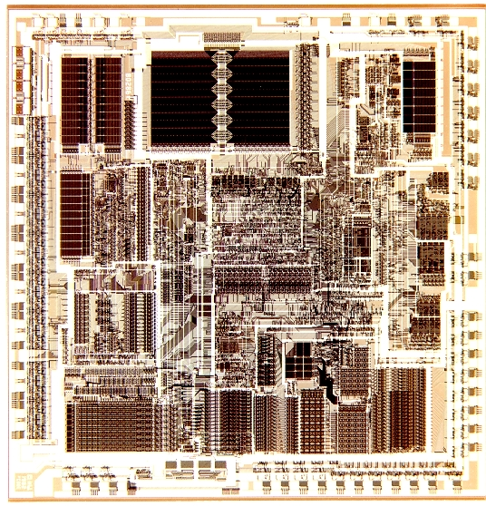
80286
Virtual memory (1982)
IBM PC AT
Characteristics
1.5 μm process
134k transistors
6-12 MHz
16-bit word size
68-pin PGA
Regular datapaths and
ROMs
Bitslices clearly visible

Slide 19
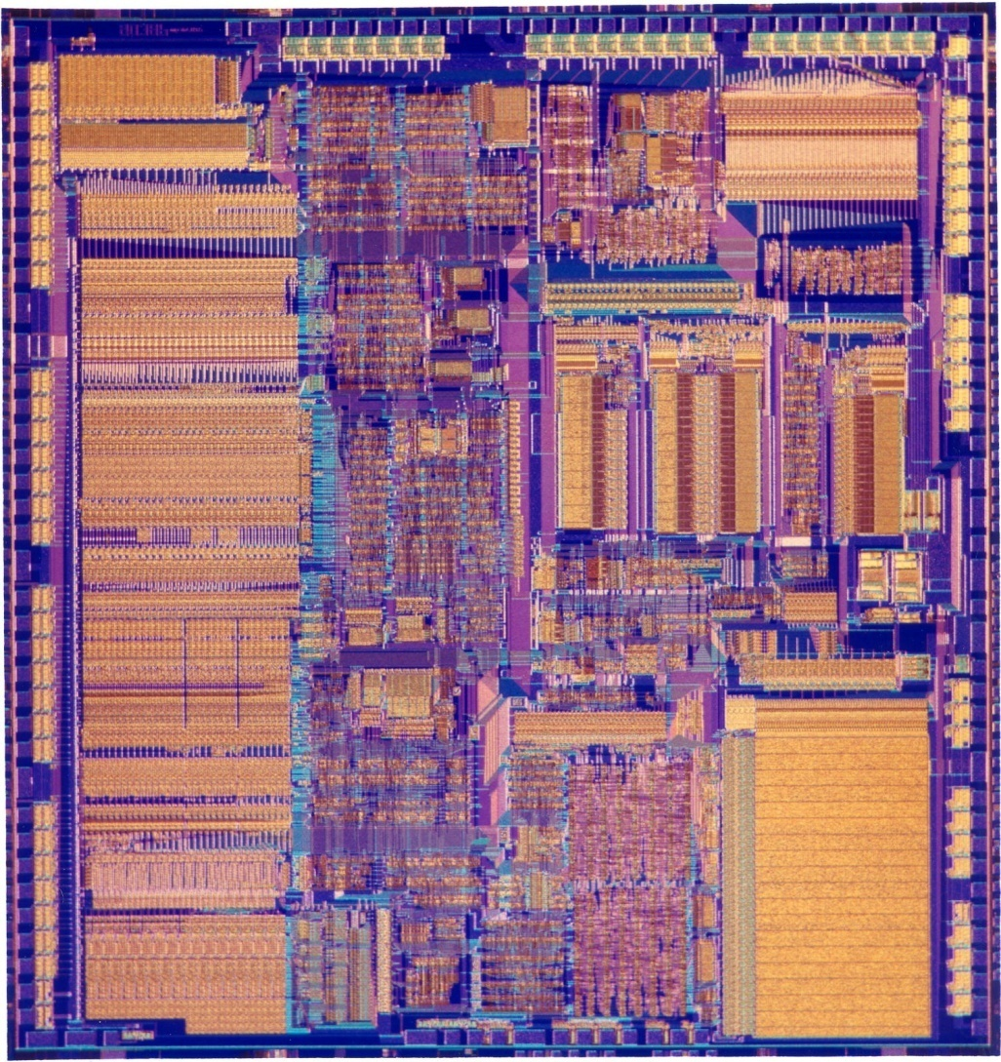
80386
32-bit processor (1985)
Modern x86 ISA
Characteristics
1.5-1 μm process
275k transistors
16-33 MHz
32-bit word size
100-pin PGA
32-bit datapath,
microcode ROM,
synthesized control

Slide 20
80486
Pipelining (1989)
Floating point unit
8 KB cache
Characteristics
1-0.6 μm process
1.2M transistors
25-100 MHz
32-bit word size
168-pin PGA
Cache, Integer datapath,
FPU, microcode,
synthesized control

Slide 21
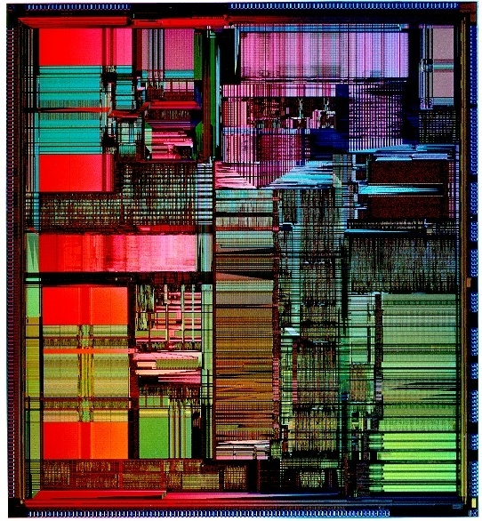
Pentium
Superscalar (1993)
2 instructions per cycle
Separate 8KB I$ & D$
Characteristics
0.8-0.35 μm process
3.2M transistors
60-300 MHz
32-bit word size
296-pin PGA
Caches, datapath,
FPU, control

Slide 22
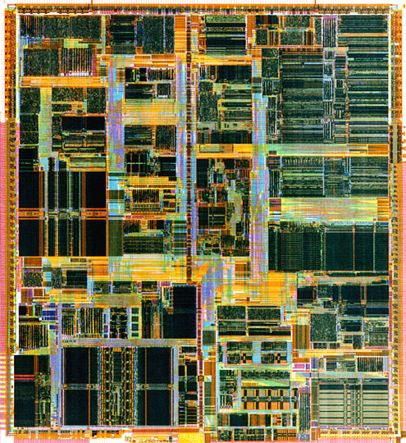
Pentium Pro / II / III
Dynamic execution (1995-9)
3 micro-ops / cycle
Out of order execution
16-32 KB I$ & D$
Multimedia instructions
PIII adds 256+ KB L2$
Characteristics
0.6-0.18 μm process
5.5M-28M transistors
166-1000 MHz
32-bit word size
MCM / SECC

Slide 23
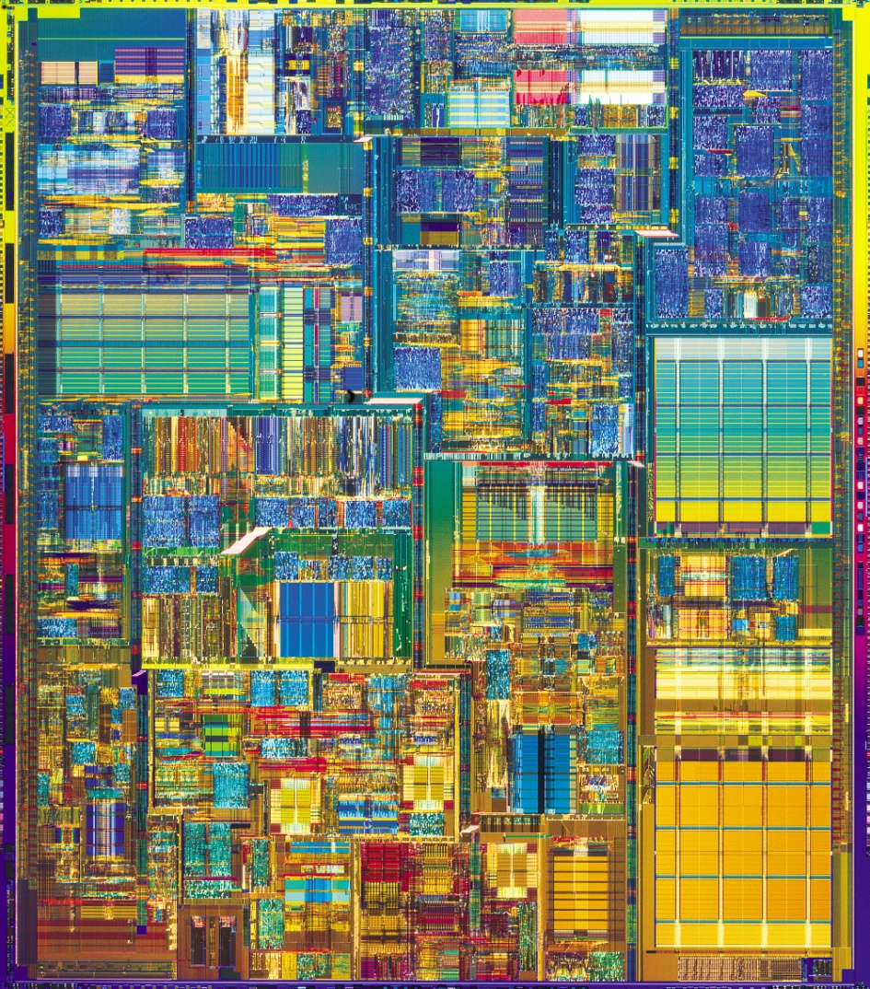
Pentium 4
Deep pipeline (2001)
Very fast clock
256-1024 KB L2$
Characteristics
180 – 90 nm process
42-125M transistors
1.4-3.4 GHz
32-bit word size
478-pin PGA
Units start to become
invisible on this scale

Slide 24
Processor list Earlier
Processor list

Slide 25
Best Processors January 2021

Slide 26
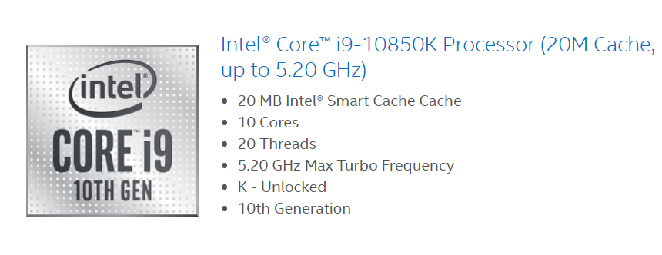
A core, or CPU core, is the "brain" of a CPU. It receives instructions, and performs calculations, or operations, to satisfy those instructions. A CPU can have multiple cores.
What are Threads in Computer Processor or CPU?
Threads are the virtual components or codes, which divides the physical core of a CPU into virtual multiple cores.
A single CPU core can have up-to 2 threads per core.
For example, if a CPU is dual core (i.e., 2 cores) it will have 4 threads. And if a CPU is Octal core (i.e., 8 core) it will have 16 threads and vice-versa.
Working: The threads are always created by the operating system for performing a task of a specific application.

Slide 27
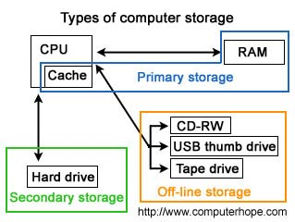
Secondary Storage Device
Alternatively referred to as
external memory or
auxiliary storage or
secondary storage device
non-volatile medium
Example:
Harddisk we use.

Slide 28
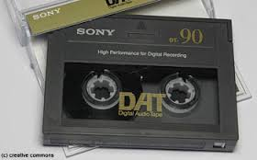
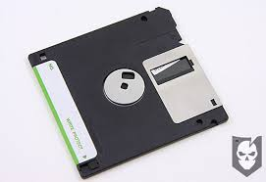
Types of Secondary Storage Media
Magnetic Tape
Floppy Disk

Slide 29
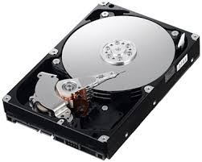
Types of Secondary Storage Media
Hard Disk
Optical Disk
Data is read and written to by using a low-powered laser beam
Two types:
CD (Compact Disk)
DVD (Digital Versatile Disk)

Slide 30
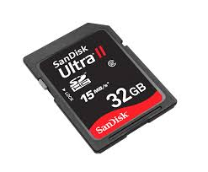
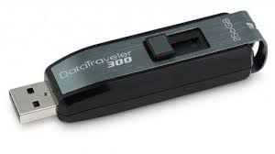
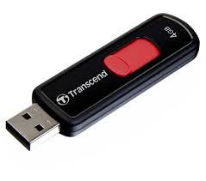
Types of Secondary Storage Media
Flash Drive
Flash Memory Cards or Flash Card
Flash memory is basically a form of EEPROM, which is a type of Read Only Memory.
All pen drives are flash drives
Mobile use memory is flash memory.
Using including digital cameras, mobile phones, laptop

Slide 31
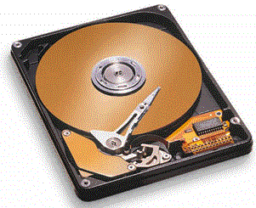
Hard Disk

Slide 32
Tracks and sectors
Can store 512 bytes
Sector =
small arc of track
Track=
concentric circle

Slide 33
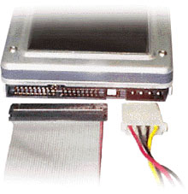
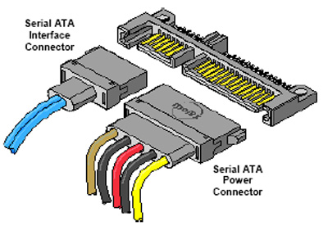
Types of Hard Disk
IDE Hard Disk (Old now) 40 pin for pc/laptop
SATA (Serial Advanced Technology Attachment) Hard Disk 7 pin for pc/laptop
SCSI (Small Computer System Interface )Hard Disk for server
SAS (Serial Attached SCSI ) for server

Slide 34
Small Computer System Interface (SCSI)
SCSI is a set of standards for physically connecting and transferring data between computers and peripheral devices
SCSI standards define commands, protocols, and electrical and optical interfaces
SCSI is most commonly used for hard disks and tape drives
SCSI connect a wide range of other devices, including scanners and CD drives

Slide 35
Why SAS better to SATA
While typical SATA drives operate at 7200RPM, a SAS drive operates at 10K or 15K. Although the platter speed is double that of SATA, the MTBF (Mean Time Before Failure) remains at the industry standard of 1.2 million hours.
SAS drives are typically utilized in server and high-end workstation environments where speed and I/O frequency reign supreme.

Slide 36
Hard drive brands
The most well-known hard drive brands include
Seagate,
Western Digital,
Toshiba and
Hitachi

Slide 37
Types of Memory
We will discuss three types of memory:
RAM
ROM
Cache

Slide 38
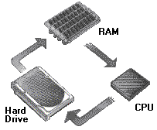
Memory

Slide 39
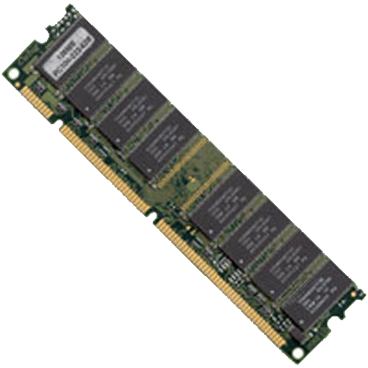
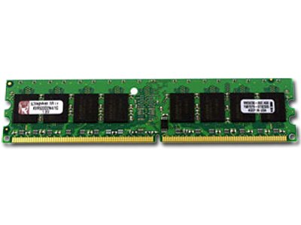
Types of RAM
DDR4 SDRAM
double data rate
in 2011
The new chips are expected to run at 1.2 V or less,^{[11][12]} versus the 1.5 V of DDR3 chips,
and have in excess of 2 billion data transfers per second.
They are expected to be introduced at frequency rates of 2133 MHz, estimated to rise to a potential 4266 MHz^{[13]} and lowered voltage of 1.05 V^{[14]} by 2013.
SDRAM
Synchronous dynamic random-access memory (SDRAM)
1970-1990

Slide 40
Ports
serial port
A port, or interface, that can be used for serial communication, in which only 1 bit is transmitted at a time.
Most serial ports on personal computers conform to the RS-232C or RS-422 standards. A serial port is a general-purpose interface that can be used for almost any type of device, including modems, mice, and printers (although most printers are connected to a parallel port).
parallel port
A parallel interface for connecting an external device such as a printer. Most personal computers have both a parallel port and at least one serial port.
On PCs, the parallel port uses a 25-pin connector (type DB-25) and is used to connect printers, computers and other devices that need relatively high bandwidth

Slide 41


